Slide 1

General linear model
StatsUnboxed
Maxime Bergevin, MSc

Slide 2

Simple regression
…and further afield
Slides with the “…and further afield” sticker are not critical to your understanding and are for those who want more information on the mathematical background.
💡
This course assumes a working knowledge of R. An excellent free and mostly official resource is the book R for Data Science by Hadley Wickham.
Note: R is not strictly necessary to understand the material. However, it is the most versatile and specialize tool to perform statistical analyses. Despite being a programming language, it is intuitive, in big part because of the tidyverse environment. Other free popular tools using a user interface include Jamovi and JASP.
Notes:
Additional note
💡 SS_{t} does not have a direct interpretation in the original units of measurement, as it is in units of “pain level squared”. It represents the total variability in the dataset relative to the grand mean, but because of the squaring, it doesn’t correspond directly to a tangible quantity like pain level. Despite not being interpretable on its own in terms of the original units, SS_{t} is extremely useful in the context of ANOVA, because it forms the basis for portioning the variability in the data into components that are attributable to the different sources (between- and within-groups). It is thus mainly a comparative measure. It is used to calculate the F-statistics when compared to SS_{w} and SS_{b}. The F-statistic, in turn, helps to determine whether the differences between group means are statistically significant.
To get back to a scale that is interpretable in the original units, you would take the square root of the average of these squared differences (i.e., the standard deviation), which provides a measure of dispersion that is in the same unit as the original data.

Slide 3
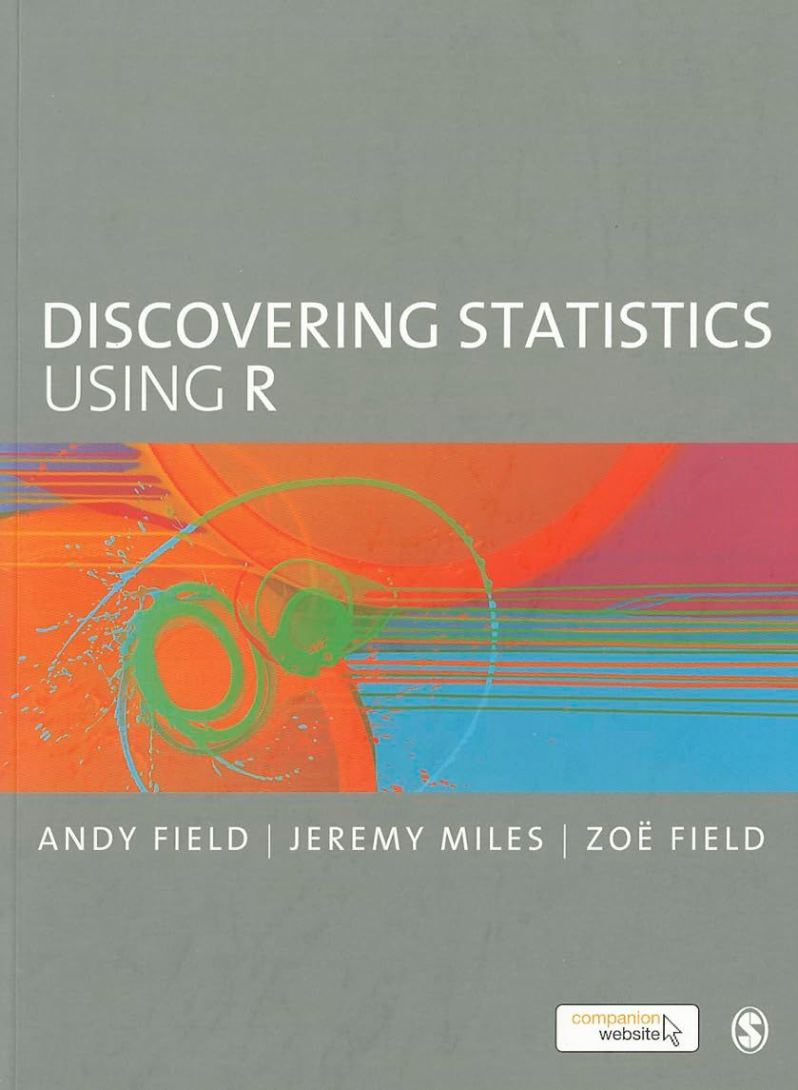
Simple regression
…and further afield
Slides with the “…and further afield” sticker are not critical to your understanding and are for those who want more information on the mathematical background.
💡
An excellent book for a gentle approach to statistics is “Discovering statistics using R” by Andy Field.
Note: If coding is something that you would rather avoid, there is also a version of this book focused on SPSS (“Discovering statistics using SPSS”). However, my general experience with SPSS has been overall unpleasant. Furthermore, SPSS is a paid software, which is why I would still encourage you to explore other free and excellent options like Jamovi and JASP.
Notes:
Additional note
💡 SS_{t} does not have a direct interpretation in the original units of measurement, as it is in units of “pain level squared”. It represents the total variability in the dataset relative to the grand mean, but because of the squaring, it doesn’t correspond directly to a tangible quantity like pain level. Despite not being interpretable on its own in terms of the original units, SS_{t} is extremely useful in the context of ANOVA, because it forms the basis for portioning the variability in the data into components that are attributable to the different sources (between- and within-groups). It is thus mainly a comparative measure. It is used to calculate the F-statistics when compared to SS_{w} and SS_{b}. The F-statistic, in turn, helps to determine whether the differences between group means are statistically significant.
To get back to a scale that is interpretable in the original units, you would take the square root of the average of these squared differences (i.e., the standard deviation), which provides a measure of dispersion that is in the same unit as the original data.

Slide 4
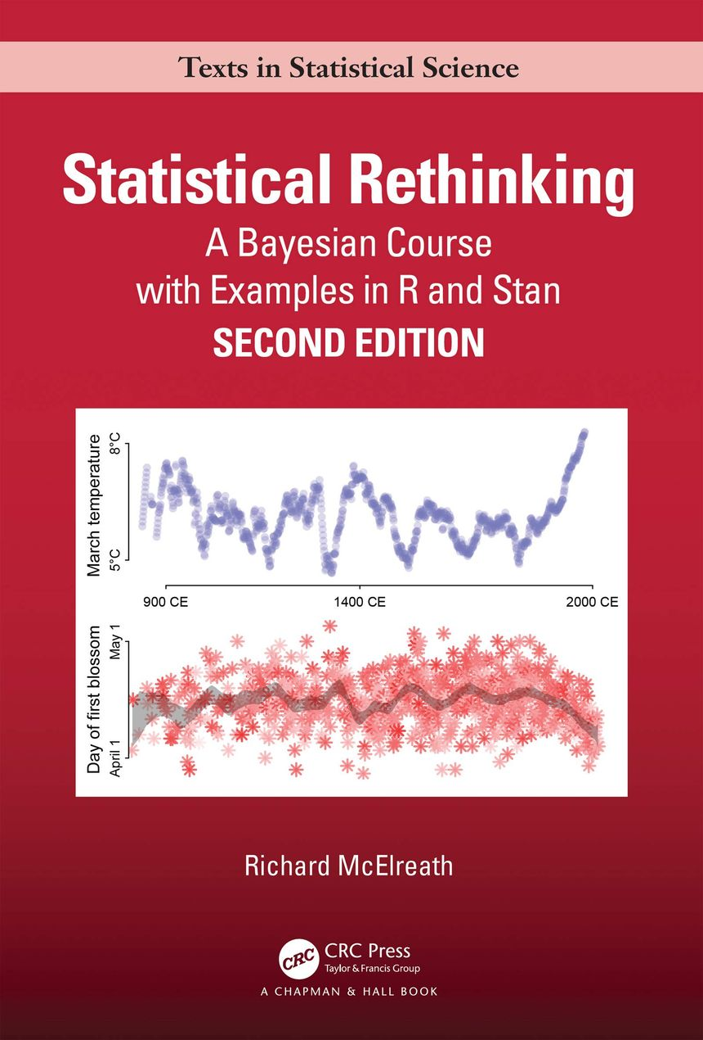
Simple regression
…and further afield
Slides with the “…and further afield” sticker are not critical to your understanding and are for those who want more information on the mathematical background.
💡
Statistical Rethinking is a more advanced book focusing on multilevel Bayesian statistics. It may be an interesting read for those wanting to delve deeper into statistics.
Note: These are the resources I have personally used to learn statistics. There are other excellent resources out there and I encourage you to explore them!
Notes:
Additional note
💡 SS_{t} does not have a direct interpretation in the original units of measurement, as it is in units of “pain level squared”. It represents the total variability in the dataset relative to the grand mean, but because of the squaring, it doesn’t correspond directly to a tangible quantity like pain level. Despite not being interpretable on its own in terms of the original units, SS_{t} is extremely useful in the context of ANOVA, because it forms the basis for portioning the variability in the data into components that are attributable to the different sources (between- and within-groups). It is thus mainly a comparative measure. It is used to calculate the F-statistics when compared to SS_{w} and SS_{b}. The F-statistic, in turn, helps to determine whether the differences between group means are statistically significant.
To get back to a scale that is interpretable in the original units, you would take the square root of the average of these squared differences (i.e., the standard deviation), which provides a measure of dispersion that is in the same unit as the original data.

Slide 5
Toy experiment
id | Vo2max | pain
1 | 48.7 | 6
2 | 29.4 | 7
3 | 38.6 | 4
4 | 41.3 | 4
5 | 39.0 | 7
6 | 33.9 | 6
7 | 50.1 | 4
8 | 34.0 | 6
9 | 55.2 | 5
10 | 34.4 | 8
11 | 48.0 | 5
12 | 57.9 | 4
13 | 21.1 | 7
14 | 32.2 | 7
15 | 33.7 | 6
We measured the VO₂max of 15 subjects, i.e., how good their cardio is.
We also measured the level of pain they have experienced when we placed a thermal probe set at 45°C on their forearm.
What we want to do: check if any trend appears when we compare their experienced pain level with their VO₂max.
See Amanda et al., Sports Med, 2022 for more info on pain perceptions in athletes.
Data randomly generated using these R command
set.seed(42) # Always run before simulating data for reproducibility
# A tibble is a type of table used in R. They are similar to data frames.
simpleRegression.data <- tibble(
# Set subject’s unique ID from 1 to 15.
id = 1:15,
# Generate a set of 15 random numbers following a normal distribution
# with mean of 35 and a standard deviation of 10 (arbitrary values).
vo2max = rnorm(15, mean = 35, sd = 10),
# Generate a set of 15 random numbers following a normal distribution
# that will be negatively related to vo2max.
pain = 7 – scale(vo2max)[,1] + rnorm(15, mean = 0, sd = 1) )
Notes:
How was the data generated?
✅This function allows us to make random simulation reproducible. `rnorm` would always give us different values if we didn’t use the set.seed() method. The 42 in the function was arbitrarily chosen and does not reflect anything that is inherently special – we could have just as well replaced 42 and 987542541. However, always running set.seed(42) before the data simulation allows us to always get the same values, thus making our code reproducible.
✅ vo2max = rnorm(15, mean = 35, sd = 10)
* rnorm(15, mean = 35, sd = 10) → This term randomly generates 15 random numbers following a normal distribution, with a mean of 35 and a standard deviation of 10. These values were arbitrarily chosen but reflect plausible VO₂max values (expressed in ml.kg⁻¹.min⁻¹).
✅ Pain = 7 – scale(vo2max)[,1] + rnorm(15, mean = 0, sd = 1)
7 – scale(vo2max)[,1]→ As vo2max increases, the standardized value (from scale) becomes positive, and thus the pain value decreases from 7, since we subtract a positive number from 7). Conversely, as vo2max decreases, the standardized value becomes negative, and the pain value increases, since we subtract a negative number from 7). This creates an inverse relationship between vo2max and pain, where 7 is the pivot. Seven was arbitrarily chosen.
rnorm(15, mean = 0, sd = 1) → Without this, we would have a perfect relationship between vo2max and pain, because we’d simply subtract the Z-score of vo2max from 7. Thus, we generate a random sample of 15 numbers following a normal distribution, with a mean of 0 and a standard deviation of 1. This is simply to add some additional noise in the data, since no measurement is perfectly accurate, and we’ll always have to deal with some degree of error. 😉

Slide 6
What is linear regression?
Used to model the linear relationship between two variables by fitting an equation to observed data.
Most of the time, that line is straight. But it doesn’t have to be… More on that later.
In simple regression, we have two variables…
Independent variable (or predictor): this is the variable we use to predict the outcome.
Dependent variable (or outcome): this is the variable we are trying to predict.
In this example, we are trying to predict the pain level based on the subjects’ VO₂max. This allows us to model the relationship between these variables.
We can already observe a trend by visualizing the data. But now, we need to find ways to make that figure talk.

Slide 7
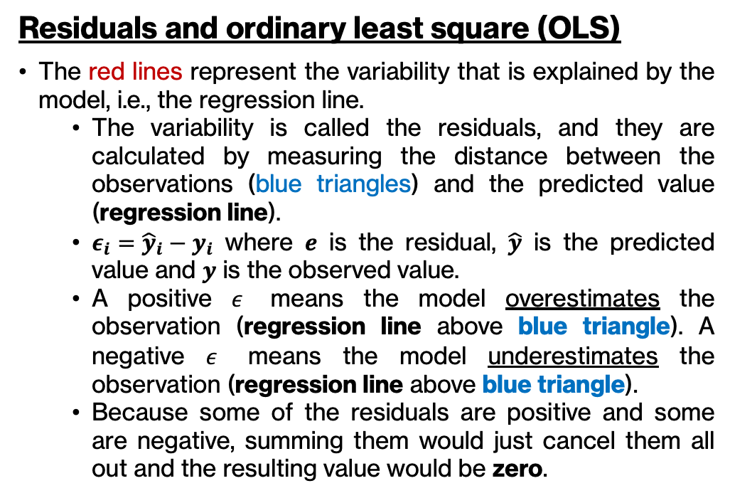
Simple regression
Logic of simple regression: We want to find the (straight*) line that minimizes the residuals (red lines on the plot).
Residuals and ordinary least square (OLS)
The red lines represent the variability that is explained by the model, i.e., the regression line.
The variability is called the residuals, and they are calculated by measuring the distance between the observations (blue triangles) and the predicted value (regression line).
$ε_{i}={\hat{y}}_{i}−y_{i}$ where $e$ is the residual, $\hat{y}$ is the predicted value and $y$ is the observed value.
A positive $ε$ means the model overestimates the observation (regression line above blue triangle). A negative $ε$ means the model underestimates the observation (regression line above blue triangle).
Because some of the residuals are positive and some are negative, summing them would just cancel them all out and the resulting value would be zero.
* The line does not actually have to be straight, but most of the time, it is. We can however model curvy lines (e.g., quadratics) as long as the formula remains mathematically linear.

Slide 8
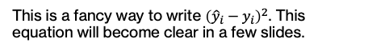
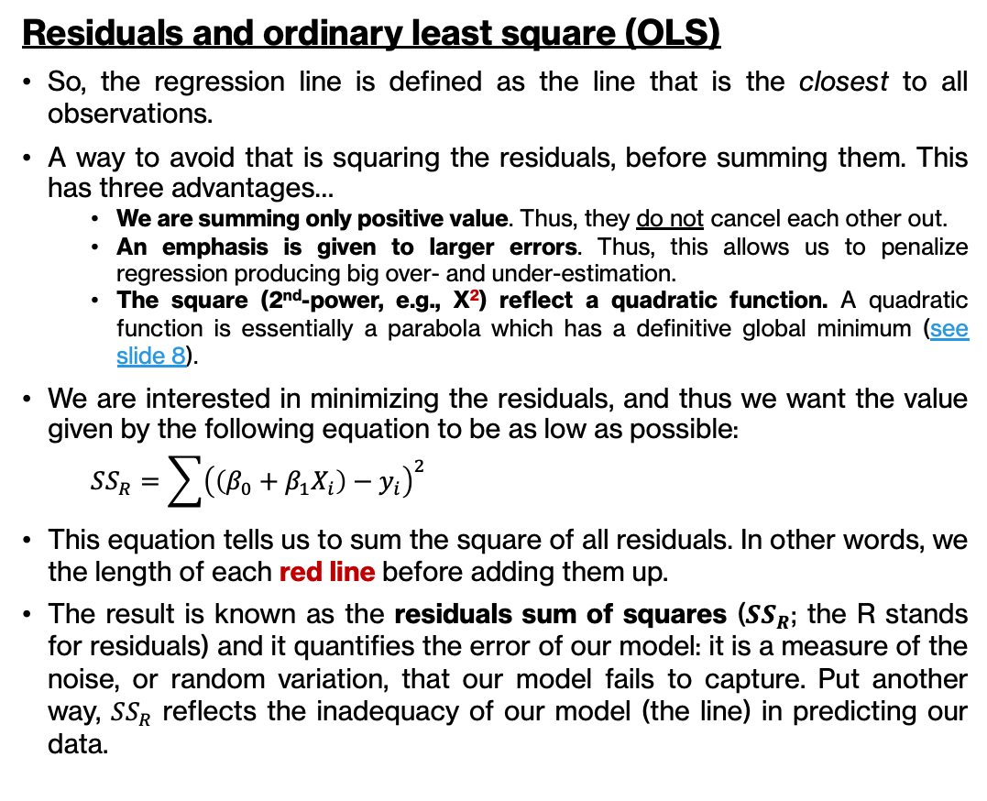
Simple regression
Logic of simple regression: We want to find the (straight*) line that minimizes the residuals (red lines on the plot).
Residuals and ordinary least square (OLS)
So, the regression line is defined as the line that is the closest to all observations.
A way to avoid that is squaring the residuals, before summing them. This has three advantages…
We are summing only positive value. Thus, they do not cancel each other out.
An emphasis is given to larger errors. Thus, this allows us to penalize regression producing big over- and under-estimation.
The square (2nd-power, e.g., X²) reflect a quadratic function. A quadratic function is essentially a parabola which has a definitive global minimum (see slide 8).
We are interested in minimizing the residuals, and thus we want the value given by the following equation to be as low as possible:
$$SS_{R}=\sum{{\left(\left(β_{0}+β_{1}X_{i}\right)−y_{i}\right)}^{2}}$$
This equation tells us to sum the square of all residuals. In other words, we the length of each red line before adding them up.
The result is known as the residuals sum of squares ($SS_{R}$; the R stands for residuals) and it quantifies the error of our model: it is a measure of the noise, or random variation, that our model fails to capture. Put another way, $SS_{R}$ reflects the inadequacy of our model (the line) in predicting our data.
This is a fancy way to write ${\left({\hat{y}}_{i}−y_{i}\right)}^{2}$. This equation will become clear in a few slides.
* The line does not actually have to be straight, but most of the time, it is. We can however model curvy lines (e.g., quadratics) as long as the formula remains mathematically linear.

Slide 9
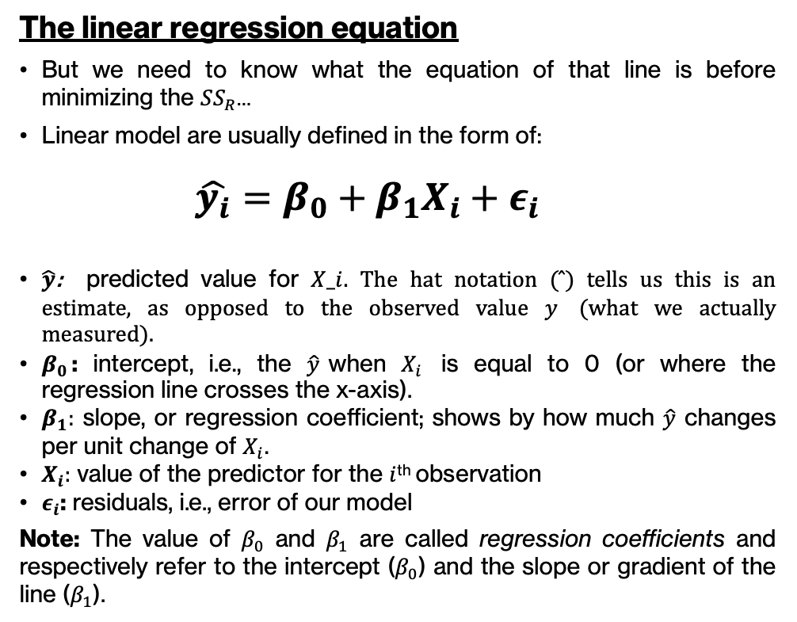
Simple regression
Logic of simple regression: We want to find the (straight*) line that minimizes the residuals (red lines on the plot).
The linear regression equation
But we need to know what the equation of that line is before minimizing the $SS_{R}$…
Linear model are usually defined in the form of:
$$\hat{y_{i}}=β_{0}+β_{1}X_{i}+ε_{i}$$
$\hat{y}$: predicted value for $X_i$. The hat notation ($̂$) tells us this is an estimate, as opposed to the observed value $y$ (what we actually measured).
$β_{0}$: intercept, i.e., the $\hat{y}$when $X_{i}$ is equal to 0 (or where the regression line crosses the x-axis).
$β_{1}:$ slope, or regression coefficient; shows by how much $\hat{y}$ changes per unit change of $X_{i}$.
$X_{i}:$ value of the predictor for the $i$^{th} observation
$ε_{i}$: residuals, i.e., error of our model
Note: The value of $β_{0}$ and $β_{1}$ are called regression coefficients and respectively refer to the intercept ($β_{0}$) and the slope or gradient of the line ($β_{1}$).
* The line does not actually have to be straight, but most of the time, it is. We can however model non-linear as long as the formula remains mathematically linear.

Slide 10
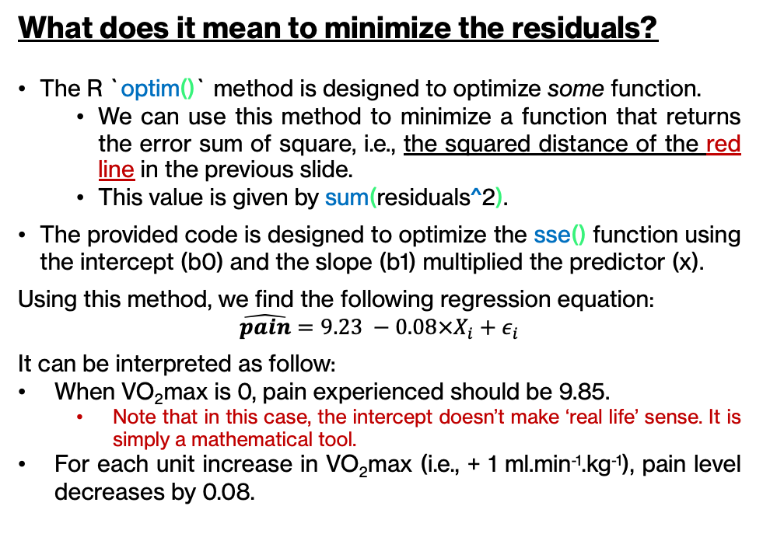
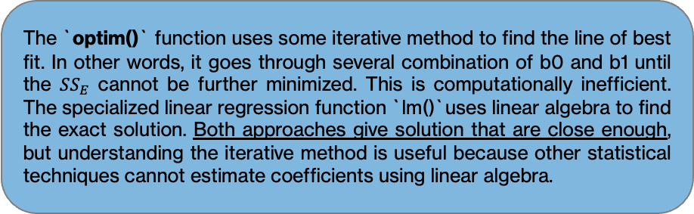
Simple regression
# A tibble is a type of table used in R. They are similar to data frames.
sse <- function(params, x, y){
b0 <- params[1] # Intercept
b1 <- params[2] # Slope
predictions <- b0 + b1*x # Traditional regression formula
residuals <- y – predictions # Vector containing all residuals
sum(residuals^2) # Error sum of squares
}
optim(
par = c(b0 = 0, b1 = 0),
fn = sse,
x = simpleRegression.data$vo2max,
y = simpleRegression.data$pain,
control = list(
reltol = 1e-16
)
)
What does it mean to minimize the residuals?
The R `optim()` method is designed to optimize some function.
We can use this method to minimize a function that returns the error sum of square, i.e., the squared distance of the red line in the previous slide.
This value is given by sum(residuals^2).
The provided code is designed to optimize the sse() function using the intercept (b0) and the slope (b1) multiplied the predictor (x).
Using this method, we find the following regression equation:
$$\hat{pain}=9.23 −0.08×X_{i}+ε_{i}$$
It can be interpreted as follow:
When VO₂max is 0, pain experienced should be 9.85.
Note that in this case, the intercept doesn’t make ‘real life’ sense. It is simply a mathematical tool.
For each unit increase in VO₂max (i.e., + 1 ml.min⁻¹.kg⁻¹), pain level decreases by 0.08.
💡
The `optim()` function uses some iterative method to find the line of best fit. In other words, it goes through several combination of b0 and b1 until the $SS_{E}$ cannot be further minimized. This is computationally inefficient. The specialized linear regression function `lm()`uses linear algebra to find the exact solution. Both approaches give solution that are close enough, but understanding the iterative method is useful because other statistical techniques cannot estimate coefficients using linear algebra.
Notes:
Additional note
💡 The `optim()` method is not ideal when solving for closed-form solutions, which is the case in ordinary least square. `optim()` works by trying out a series of parameters and calculating the error sum of squares for each. It stops when it deems the difference in error sum of square was sufficiently small compared to the previous iteration. While this may be appropriate when we have good starting values (e.g., an idea of intercept and slope values that make sense), this may lead to some issues if our starting values are usually far from the exact solution.
👉 Part of the reason is because the algorithm is a golem that “doesn’t think”, but only follows a set of instruction. Because of that, the algorithm might get “stuck” far from the exact solution. The exact reason why that is the beyond the scope of this course (and of my own brain 🙃).

Slide 11
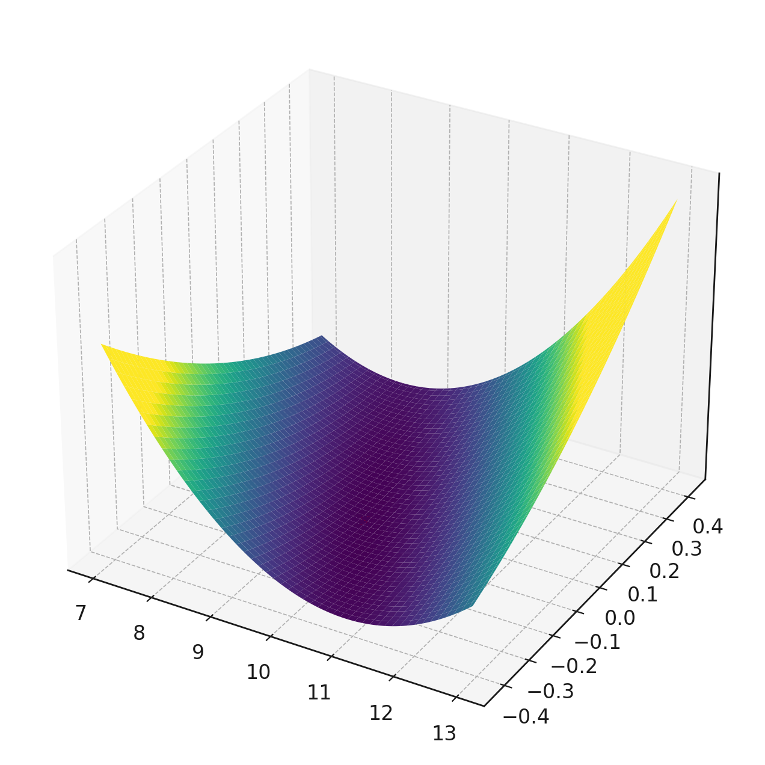
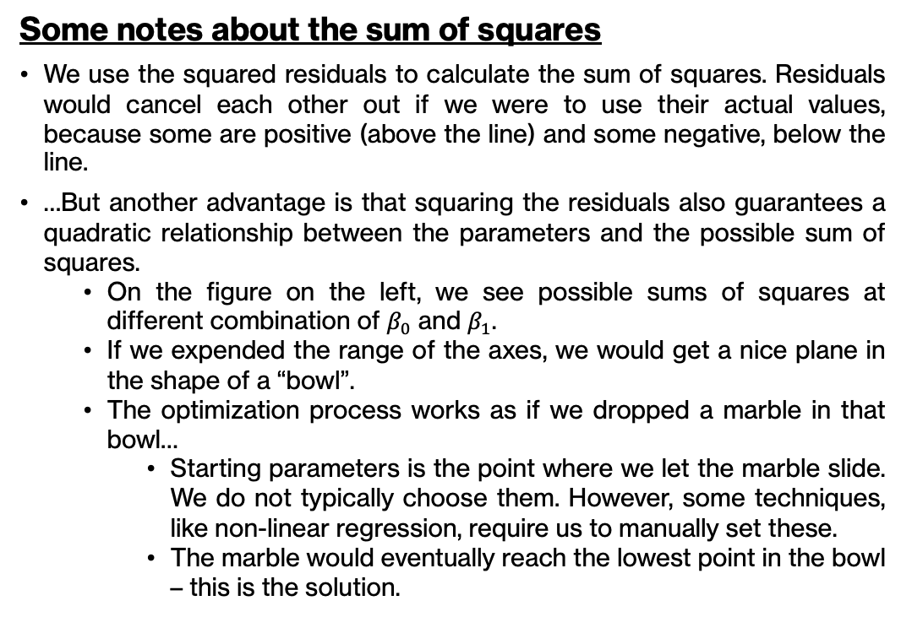

Simple regression
…and further afield
Some notes about the sum of squares
We use the squared residuals to calculate the sum of squares. Residuals would cancel each other out if we were to use their actual values, because some are positive (above the line) and some negative, below the line.
…But another advantage is that squaring the residuals also guarantees a quadratic relationship between the parameters and the possible sum of squares.
On the figure on the left, we see possible sums of squares at different combination of $β_{0}$ and $β_{1}$.
If we expended the range of the axes, we would get a nice plane in the shape of a “bowl”.
The optimization process works as if we dropped a marble in that bowl…
Starting parameters is the point where we let the marble slide. We do not typically choose them. However, some techniques, like non-linear regression, require us to manually set these.
The marble would eventually reach the lowest point in the bowl – this is the solution.
Possible SS^{e}
$$β_{0}=9.23;β_{1}=−0.08$$
Estimated slopes
💡
Estimated intercepts
Quadratic functions regression form a bowl-shaped surface when considering both the intercept and slope. This surface has a single lowest point, known as the global minimum, where the sum of squared errors is minimized. The quadratic and convex nature of this function allows for an exact solution through linear algebra, providing a closed-form equation to find the optimal parameters. This method, used in ordinary least squares, is computationally efficient and avoids the potentially pitfalls of iterative optimization methods.

Slide 12
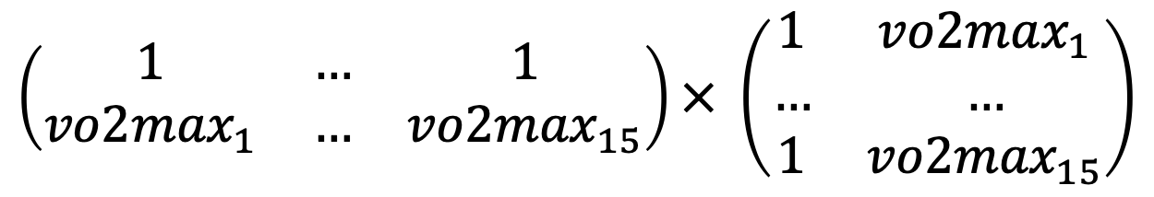
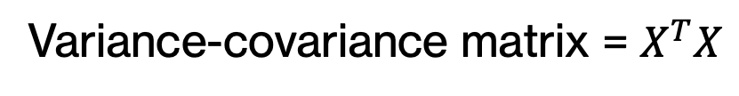
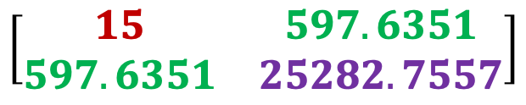
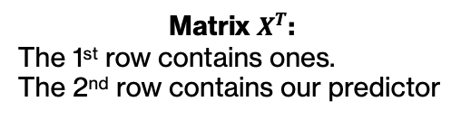
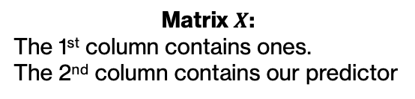
Simple regression
…and further afield
LINEAR ALGEBRA – Variance-covariance matrix
Variance-covariance matrix = $X^{T}X$
Matrix $X^{T}$:
The 1st row contains ones.
The 2nd row contains our predictor
Matrix $X$:
The 1st column contains ones.
The 2nd column contains our predictor
$$\left(\begin{matrix}1 & … & 1 \\ {vo2max}_{1} & … & {vo2max}_{15}\end{matrix}\right)× \left(\begin{matrix}1 & {vo2max}_{1} \\ … & … \\ 1 & {vo2max}_{15}\end{matrix}\right)$$
This is a “wide” version of our data frame in R (`simpleRegression.data`)
This is in the same format as our data frame in R (`simpleRegression.data`)
In red: this is essentially our n and will be related to the intercept in subsequent calculation.
In green: This is the sum of vo2max. This value will be used in the calculation of the slope coefficient. In multiple regression, the off-diagonal would reflect the covariance between our predictors. More on that later…
In purple: This is the sum of the squares of vo2max. You might recognize the `sum of square ‘ approach here. This value is related to the variance of our predictor and as such, will be used to estimate the standard error around the coefficients.
$$\left[\begin{matrix}15 & 597.6351 \\ 597.6351 & 25282.7557\end{matrix}\right]$$
Notes:
Additional note
💡 The matrix given by this operation is called the variance-covariance matrix. Here is how it is structured.
👉 First element (top left entry) → This measure is essentially the number of subject (n) and is related to the intercept.
👉 Diagonal → Going from top left to bottom right diagonal, we have the variance of our predictor variable. Note that this is not the `variance` in the traditional term. The sum of the squared values of the predictor will be used in later steps to estimate the variance of the regression coefficients.
👉 Off diagonal → Going from top right to bottom left, we have the covariance between predictor variables. In simple regression with a single predictor, there’s only one variance and no covariance to consider. However, in multiple regression, the off-diagonal entries become important.
🧠 The variance-covariance matrix is used to estimate the standard errors of the regression coefficients, which are crucial for hypothesis testing and constructing confidence intervals around the estimated coefficients.

Slide 13
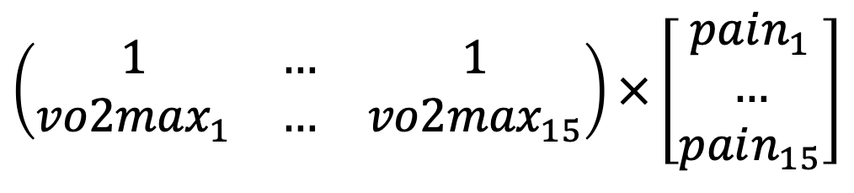
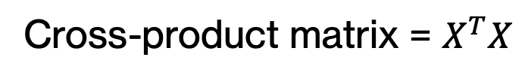
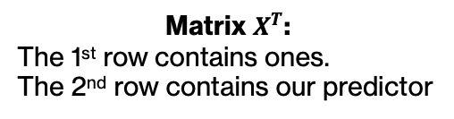
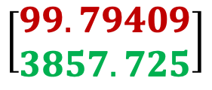
Simple regression
…and further afield
LINEAR ALGEBRA – Cross-product matrix
Cross-product matrix = $X^{T}X$
Matrix $X^{T}$:
The 1st row contains ones.
The 2nd row contains our predictor
Vector Y:
This vector contains all our outcomes.
$$\left(\begin{matrix}1 & … & 1 \\ {vo2max}_{1} & … & {vo2max}_{15}\end{matrix}\right)×\left[\begin{aligned}pain_{1} \\ … \\ pain_{15}\end{aligned}\right]$$
In red: This is the sum of all our outcome values across all subjects. It represents the total “weight” of the response variable, necessary to balance the normal equation for estimating the intercept.
In green: This is the sum of squares of the product all our outcome and predictor values across all subjects and represents the covariation between the predictor and the response. It measures how much the predictor variable and the response variable tend to increase or decrease together. This value allows us to determine the slope based on how much change in the response variable is associated with a unit change in the predictor.
$$\left[\begin{aligned}99.79409 \\ 3857.725\end{aligned}\right]$$

Slide 14
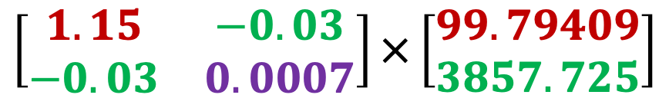
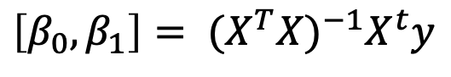
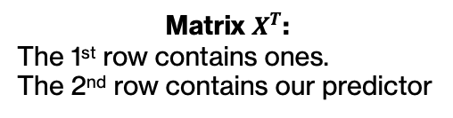
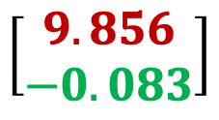
We already calculated what is highlighted in blue
Simple regression
$\left[β_{0},β_{1}\right]= {(X}^{T}{X)}^{−1}X^{t}y$
…and further afield
LINEAR ALGEBRA – Normal equation
Final step! 🥳🎉
Matrix $X^{T}$:
The 1st row contains ones.
The 2nd row contains our predictor
Vector Y:
This vector contains all our outcomes.
$$\left[\begin{matrix}1.15 & −0.03 \\ −0.03 & 0.0007\end{matrix}\right]×\left[\begin{aligned}99.79409 \\ 3857.725\end{aligned}\right]$$
This is the inverse of the variance-covariance matrix. Is it equivalent to the reciprocal of a number (e.g., 5⁻¹). This is like dividing the cross-product matrix by the variance-covariance matrix.
$$\left[\begin{aligned}9.856 \\ −0.083\end{aligned}\right]$$
In red: This is the sum of all our outcome values across all subjects. It represents the total “weight” of the response variable, necessary to balance the normal equation for estimating the intercept.
In green: This is the sum of squares of all our outcome values across all subjects and represents the covariation between the predictor and the response. It measures how much the predictor variable and the response variable tend to increase or decrease together. This value allows us to determine the slope based on how much change in the response variable is associated with a unit change in the predictor.
💡
The normal equation is a mathematical solution that directly calculates the coefficients of the regression line that minimize the sum of squared residuals. It achieves this by analytically solving a set of linear equations derived from setting the derivatives of the sum of squared residuals with respect to each coefficient to zero – a standard method in calculus for finding minimum or maximum value of a function.
The mathematics is out of scope of this course. People interested can refer to this excellent Youtube video by jbstatistics.
Notes:
Additional note
💡 How the intercept is calculated…
1.14538432 * 99.79409 = 114.3026. Here, we are multiplying the “inverse” related to the intercept and the sum of the outcome values. Because the first entry of our variance-covariance design was n, this product is “somewhat” similar to dividing the sum of all our outcome values by n (doesn’t that sound like calculating the average?🤔). While it is not exactly calculating the mean of the outcome, it is a way to adjust the total sum of the outcome by the scale of the dataset (i.e., we remove the bias introduce in that value by the size of our sample). In other words, it scales our intercept to the size of our dataset (here, to n = 15).
-0.02707466 * 3857.72501 = -104.446. Here, we are multiplying the “inverse” of the sum of our predictor values by the sum of the product between our predictor and outcome (i.e., covariation). The covariation represents the relationship between our variables (i.e., how much they change together). The inclusion of this multiplication in the intercept calculation adjusts how the relationship between the predictor and the outcome influences the intercept.

Slide 15
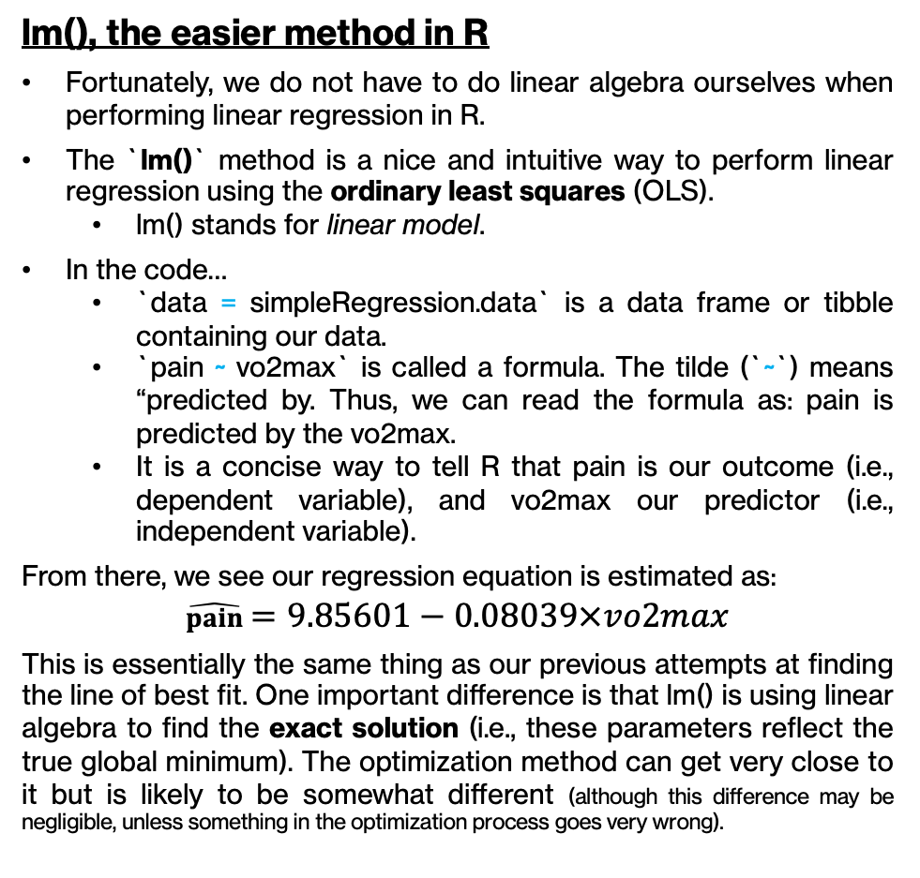
Simple regression
# `lm()` is the default R method to perform linear regression
# It leverages linear algebra to find the exact solution, unlike `optim()`
simpleRegression.lm <- lm(
data = simpleRegression.data,
pain ~ vo2max
)
summary(regression.lm)
Coefficients:
Estimate Std. Error t value Pr(>|t|)
(Intercept) 9.23367 1.09343 8.445 1.23e-06 ***
vo2max -0.08786 0.02663 -3.299 0.00576 *
---
Signif. Codes:
0 `***` 0.001 `**` 0.01 `*` 0.05 `.` 0.1 ``1
Residual standard error: 1.022 on 13 degrees of freedom
Multiple R-squared: 0.4556, Adjusted R-squared: 0.4138
F-statistic: 10.88 on 1 and 13 DF, p-value: 0.005762
lm(), the easier method in R
Fortunately, we do not have to do linear algebra ourselves when performing linear regression in R.
The `lm()` method is a nice and intuitive way to perform linear regression using the ordinary least squares (OLS).
lm() stands for linear model.
In the code…
`data = simpleRegression.data` is a data frame or tibble containing our data.
`pain ~ vo2max` is called a formula. The tilde (`~`) means “predicted by. Thus, we can read the formula as: pain is predicted by the vo2max.
It is a concise way to tell R that pain is our outcome (i.e., dependent variable), and vo2max our predictor (i.e., independent variable).
From there, we see our regression equation is estimated as:
$$\hat{pain}=9.85601−0.08039×vo2max$$
This is essentially the same thing as our previous attempts at finding the line of best fit. One important difference is that lm() is using linear algebra to find the exact solution (i.e., these parameters reflect the true global minimum). The optimization method can get very close to it but is likely to be somewhat different (although this difference may be negligible, unless something in the optimization process goes very wrong).
💡
Another nice benefit to using `lm()` is that gives you, in one simple call, several information about your regression. In addition to your estimates and their standard error, you also have access to their t- and p-value. This method also gives you some other measures, like the F-statistic of your model, it’s degrees of freedom and some measures of the goodness of fit.
(More on that later 😉)
Notes:
Additional note
💡 The `optim()` method is not ideal when solving for closed-form solutions, which is the case in ordinary least square. `optim()` works by trying out a series of parameters and calculating the error sum of squares for each. It stops when it deems the difference in error sum of square was sufficiently small compared to the previous iteration. While this may be appropriate when we have good starting values (e.g., an idea of intercept and slope values that make sense), this may lead to some issues if our starting values are usually far from the exact solution.
👉 Part of the reason is because the algorithm is a golem that “doesn’t think”, but only follows a set of instruction. Because of that, the algorithm might get “stuck” far from the exact solution. The exact reason why that is the beyond the scope of this course (and of my own brain 🙃).

Slide 16
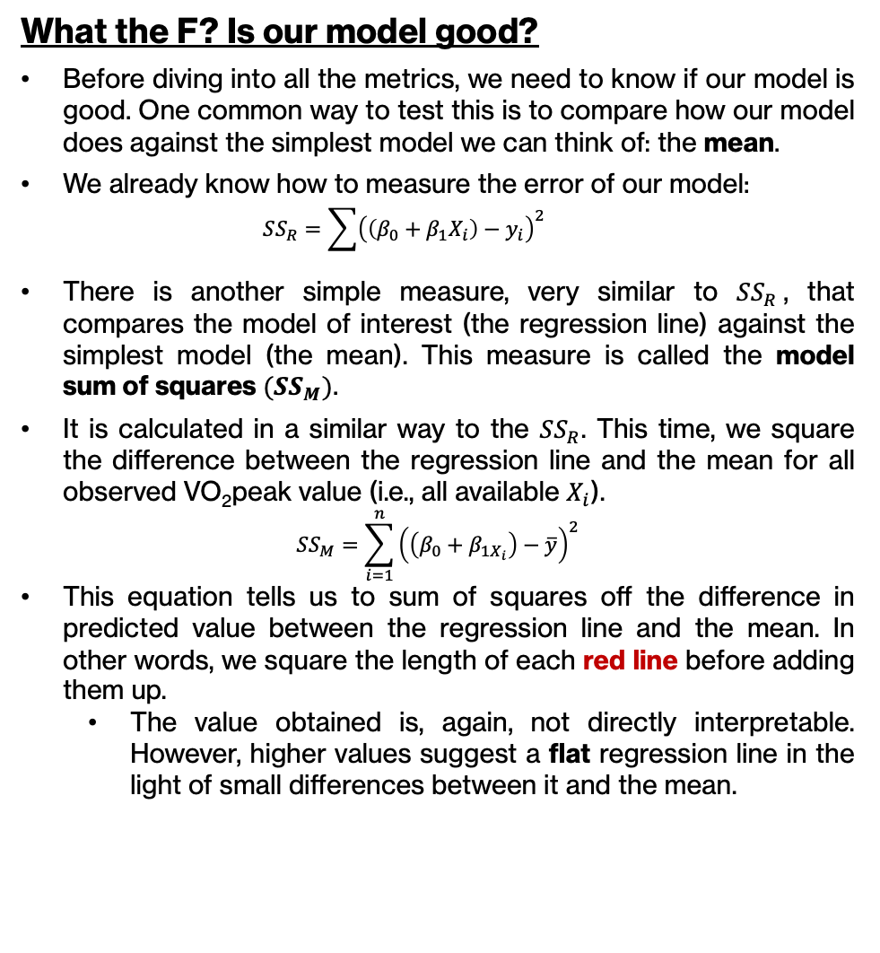
Simple regression
What the F? Is our model good?
Before diving into all the metrics, we need to know if our model is good. One common way to test this is to compare how our model does against the simplest model we can think of: the mean.
We already know how to measure the error of our model:
$$SS_{R}=\sum{{\left(\left(β_{0}+β_{1}X_{i}\right)−y_{i}\right)}^{2}}$$
There is another simple measure, very similar to $SS_{R}$, that compares the model of interest (the regression line) against the simplest model (the mean). This measure is called the model sum of squares $(SS_{M})$.
It is calculated in a similar way to the $SS_{R}$. This time, we square the difference between the regression line and the mean for all observed VO₂peak value (i.e., all available $X_{i}$).
$$SS_{M}=\sum_{i=1}^{n}{{\left(\left(β_{0}+β_{1X_{i}}\right)−\overline{y}\right)}^{2}}$$
This equation tells us to sum of squares off the difference in predicted value between the regression line and the mean. In other words, we square the length of each red line before adding them up.
The value obtained is, again, not directly interpretable. However, higher values suggest a flat regression line in the light of small differences between it and the mean.
# Run an analysis of variance on an lm() object
anova(regression.lm)
Analysis of variance Table
Df Sum Sq Mean Sq F Value Pr(F)
vo2peak 1 11.631 8.445 10.882 0.005762 **
Residuals 13 13.573 1.044
---
Signif. Codes:
0 `***` 0.001 `**` 0.01 `*` 0.05 `.` 0.1 ``1
Notes:
Additional note
💡 The model sum of squares (SSm) is also know as the sum of squares due to the regression (abbreviated SSR). I avoid this nomenclature, as R could also stand for residuals.

Slide 17
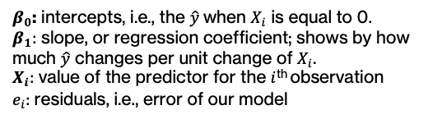
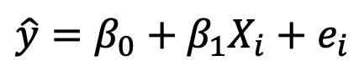
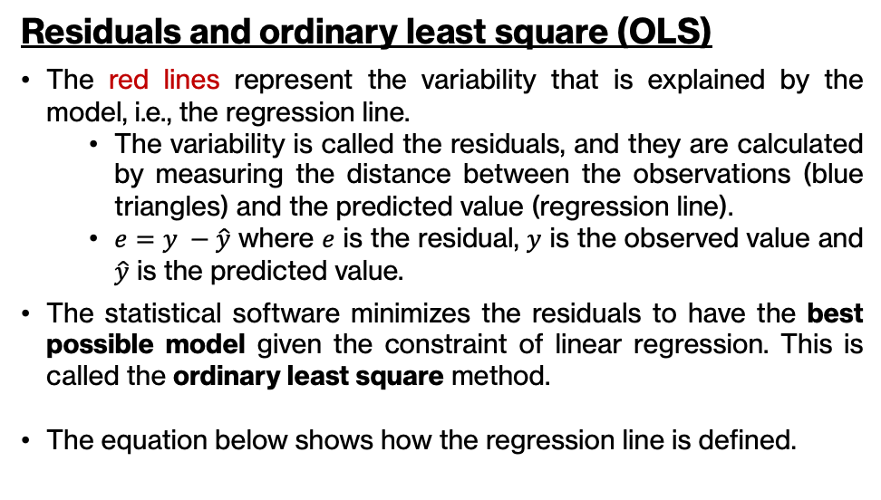
Simple regression
Logic of simple regression: We want to find the (straight*) line that minimizes the residuals and compare it to a simpler model, the mean (dashed line).
Context
We have pain levels induced by a standard thermal pain (45°C) on the forearm for (N=) 15 participants. We want to check if any trend appears when we compare their experienced pain level with the VO₂max.
See Amanda et al., Sports Med, 2022 for more info on pain perceptions in athletes.
Residuals and ordinary least square (OLS)
The red lines represent the variability that is explained by the model, i.e., the regression line.
The variability is called the residuals, and they are calculated by measuring the distance between the observations (blue triangles) and the predicted value (regression line).
$e=y −\hat{y}$ where $e$ is the residual, $y$ is the observed value and $\hat{y}$ is the predicted value.
The statistical software minimizes the residuals to have the best possible model given the constraint of linear regression. This is called the ordinary least square method.
The equation below shows how the regression line is defined.
$$\hat{y}=β_{0}+β_{1}X_{i}+e_{i}$$
$β_{0}$: intercepts, i.e., the $\hat{y}$when $X_{i}$ is equal to 0.
$β_{1}:$ slope, or regression coefficient; shows by how much $\hat{y}$ changes per unit change of $X_{i}$.
$X_{i}:$ value of the predictor for the $i$^{th} observation
$e_{i}$: residuals, i.e., error of our model
* The line does not actually have to be straight, but most of the time, it is. We can however model non-linear as long as the formula remains mathematically linear.
Notes:
Additional note
💡 SS_{t} does not have a direct interpretation in the original units of measurement, as it is in units of “pain level squared”. It represents the total variability in the dataset relative to the grand mean, but because of the squaring, it doesn’t correspond directly to a tangible quantity like pain level. Despite not being interpretable on its own in terms of the original units, SS_{t} is extremely useful in the context of ANOVA, because it forms the basis for portioning the variability in the data into components that are attributable to the different sources (between- and within-groups). It is thus mainly a comparative measure. It is used to calculate the F-statistics when compared to SS_{w} and SS_{b}. The F-statistic, in turn, helps to determine whether the differences between group means are statistically significant.
To get back to a scale that is interpretable in the original units, you would take the square root of the average of these squared differences (i.e., the standard deviation), which provides a measure of dispersion that is in the same unit as the original data.

Slide 18
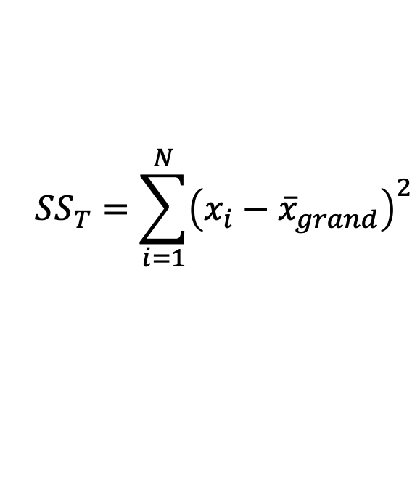
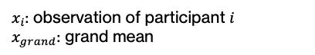
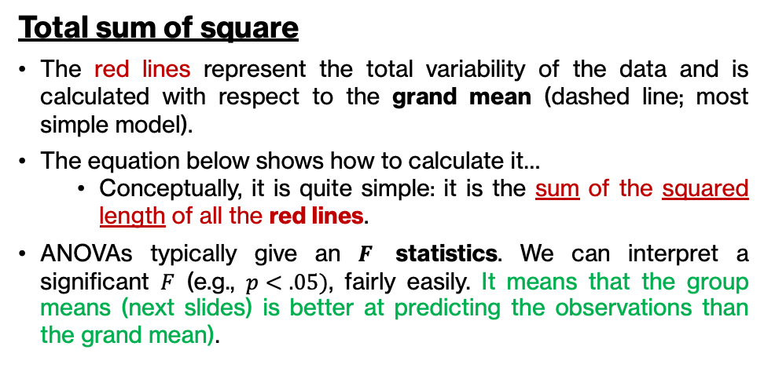
Total sum of squares
Logic of ANOVA: compare the explained (effect) and unexplained (noise) variance in our model.
This variance is derived from the total variance (total sum of square; SS_{t}). ANOVAs effectively partition this total variance.
Context
We have pain levels induced by thermal pain on the forearm for (N=) 15 participants separate between non-athletes, non-contact athletes and contact athletes (n=5 for each).
See Amanda et al., Sports Med, 2022 for more info on pain perceptions in athletes.
Total sum of square
The red lines represent the total variability of the data and is calculated with respect to the grand mean (dashed line; most simple model).
The equation below shows how to calculate it…
Conceptually, it is quite simple: it is the sum of the squared length of all the red lines.
ANOVAs typically give an $F$ statistics. We can interpret a significant $F$ (e.g., $p<.05)$, fairly easily. It means that the group means (next slides) is better at predicting the observations than the grand mean).
$$SS_{T}=\sum_{i=1}^{N}{{\left(x_{i}−{\overline{x}}_{grand}\right)}^{2}}$$
$x_{i}$: observation of participant $i$
$x_{grand}$: grand mean
Notes:
Additional note
💡 SS_{t} does not have a direct interpretation in the original units of measurement, as it is in units of “pain level squared”. It represents the total variability in the dataset relative to the grand mean, but because of the squaring, it doesn’t correspond directly to a tangible quantity like pain level. Despite not being interpretable on its own in terms of the original units, SS_{t} is extremely useful in the context of ANOVA, because it forms the basis for portioning the variability in the data into components that are attributable to the different sources (between- and within-groups). It is thus mainly a comparative measure. It is used to calculate the F-statistics when compared to SS_{w} and SS_{b}. The F-statistic, in turn, helps to determine whether the differences between group means are statistically significant.
To get back to a scale that is interpretable in the original units, you would take the square root of the average of these squared differences (i.e., the standard deviation), which provides a measure of dispersion that is in the same unit as the original data.

Slide 19
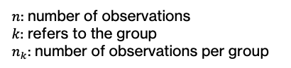
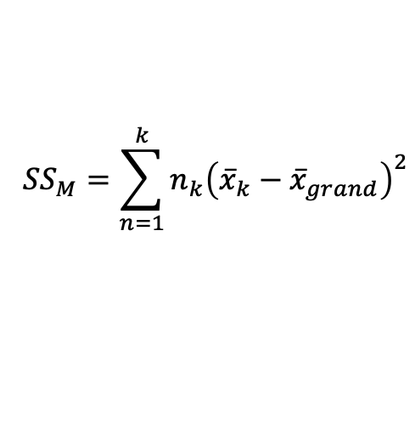
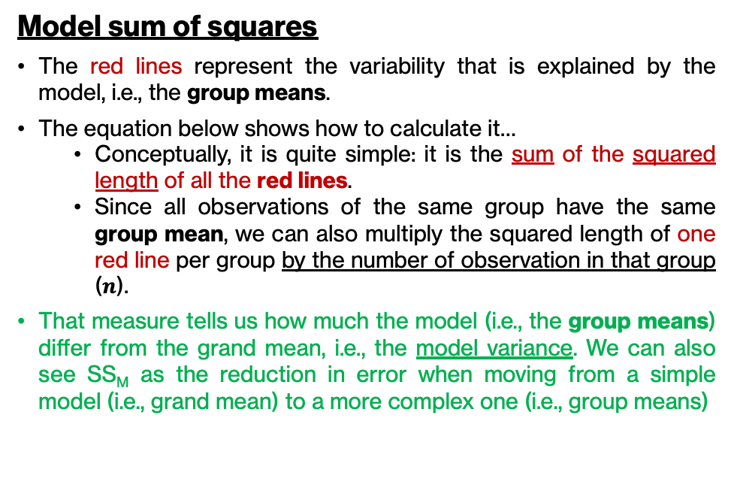
Model sum of squares
Logic of ANOVA: compare the explained (effect) and unexplained (noise) variance in our model.
The explained variance is the partition of the total variance that is predicted, or explained, by the model.
Context
We have pain levels induced by thermal pain on the forearm for (N=) 15 participants separate between non-athletes, non-contact athletes and contact athletes (n=5 for each).
See Amanda et al., Sports Med, 2022 for more info on pain perceptions in athletes.
Model sum of squares
The red lines represent the variability that is explained by the model, i.e., the group means.
The equation below shows how to calculate it…
Conceptually, it is quite simple: it is the sum of the squared length of all the red lines.
Since all observations of the same group have the same group mean, we can also multiply the squared length of one red line per group by the number of observation in that group ($n$).
That measure tells us how much the model (i.e., the group means) differ from the grand mean, i.e., the model variance. We can also see SS_{M} as the reduction in error when moving from a simple model (i.e., grand mean) to a more complex one (i.e., group means)
$$SS_{M}=\sum_{n=1}^{k}{{n_{k}\left({\overline{x}}_{k}−{\overline{x}}_{grand}\right)}^{2}}$$
$n$: number of observations
$k$: refers to the group
$n_{k}$: number of observations per group
Notes:
Additional note
💡 SS_{M} does not have a direct interpretation in the original units of measurement, as it is in units of “pain level squared”. It represents the total variability in the dataset relative to the grand mean, but because of the squaring, it doesn’t correspond directly to a tangible quantity like pain level. Despite not being interpretable on its own in terms of the original units, SS_{M} is extremely useful in the context of ANOVA, because it forms the basis for portioning the variability in that is explained by the model. It is thus mainly a comparative measure. It is used to calculate the F-statistics when compared to SS_{w} and SS_{b}. The F-statistic, in turn, helps to determine whether the differences between group means are statistically significant.
To get back to a scale that is interpretable in the original units, you would take the square root of the average of these squared differences (i.e., the standard deviation), which provides a measure of dispersion that is in the same unit as the original data.

Slide 20
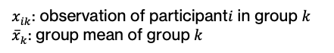
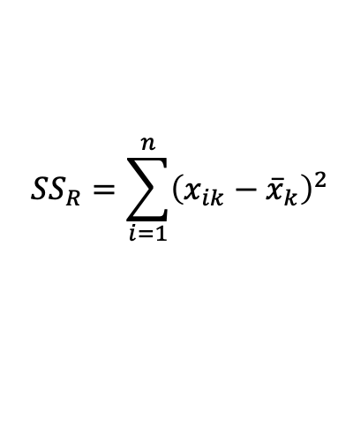
Residual sum of squares
Logic of ANOVA: compare the explained (effect) and unexplained (noise) variance in our model.
The unexplained variance is the partition of the total variance that is not predicted, or explained, by the model.
Context
We have pain levels induced by thermal pain on the forearm for (N=) 15 participants separate between non-athletes, non-contact athletes and contact athletes (n=5 for each).
See Amanda et al., Sports Med, 2022 for more info on pain perceptions in athletes.
Residual sum of squares
The red lines represent the variability that is unexplained by the model, i.e., the group means.
The equation below shows how to calculate the model sum of squares…
Conceptually, it is quite simple: it is the sum of the squared length of all the red lines.
The difference between the observations and their respective group means reflect the error of our model, i.e., the variability that our model does not account for. In regression terms, these are the residuals.
That measure tells us how much the model (i.e., the group means) is bad at predicting our observations. No model is perfect – the goal is to have a model that is at least better than the grand mean.
$$SS_{R}=\sum_{i=1}^{n}{{\left(x_{ik}−{\overline{x}}_{k}\right)}^{2}}$$
$x_{ik}$: observation of participant$i$ in group $k$
${\overline{x}}_{k}$: group mean of group $k$

Slide 21
Sums of squares
Variance explained by the model (i.e., group mean)
And now we have…
SS_{M}: model sum of squares
What is explained by the model
SS_{R}: residual sum of squares
What is unexplained by the model
Errors of the model being smaller than the errors of the residuals means that the model is at least better than the grand mean at predicting our observations. In other words, it means that at least one group mean differ from the others sufficiently enough to make our model more useful.
In other words, SS_{M} has to be smaller than SS_{R}.
Total variance
Variance unexplained by the model (i.e., group mean)

Slide 22
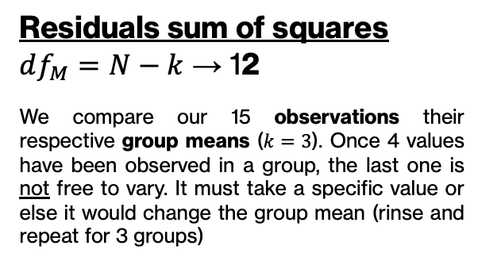
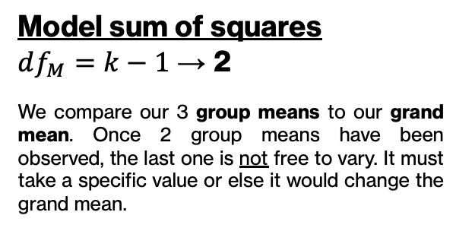
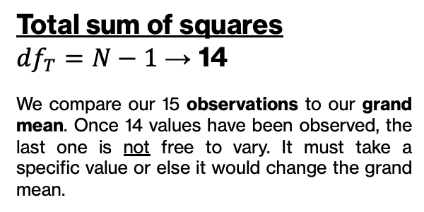
But we can’t directly use the sums of square, because they are biased by the number of scores being summed (i.e., number of observations and groups). We use the average sum of squares (i.e., mean squares), which is obtained by dividing the sums of squares by their respective degrees of freedom.
Total sum of squares
$df_{T}=N−1$ → 14
We compare our 15 observations to our grand mean. Once 14 values have been observed, the last one is not free to vary. It must take a specific value or else it would change the grand mean.
Model sum of squares
$df_{M}=k−1$ → 2
We compare our 3 group means to our grand mean. Once 2 group means have been observed, the last one is not free to vary. It must take a specific value or else it would change the grand mean.
Residuals sum of squares
$df_{M}=N−k$ → 12
We compare our 15 observations their respective group means ($k=3$). Once 4 values have been observed in a group, the last one is not free to vary. It must take a specific value or else it would change the group mean (rinse and repeat for 3 groups)

Slide 23
Sums of squares
Variance explained by the model (i.e., group mean)
Total variance
Variance unexplained by the model (i.e., group mean)

Slide 24
General linear model
StatsUnboxed
How to interpret confidence intervals

Slide 25
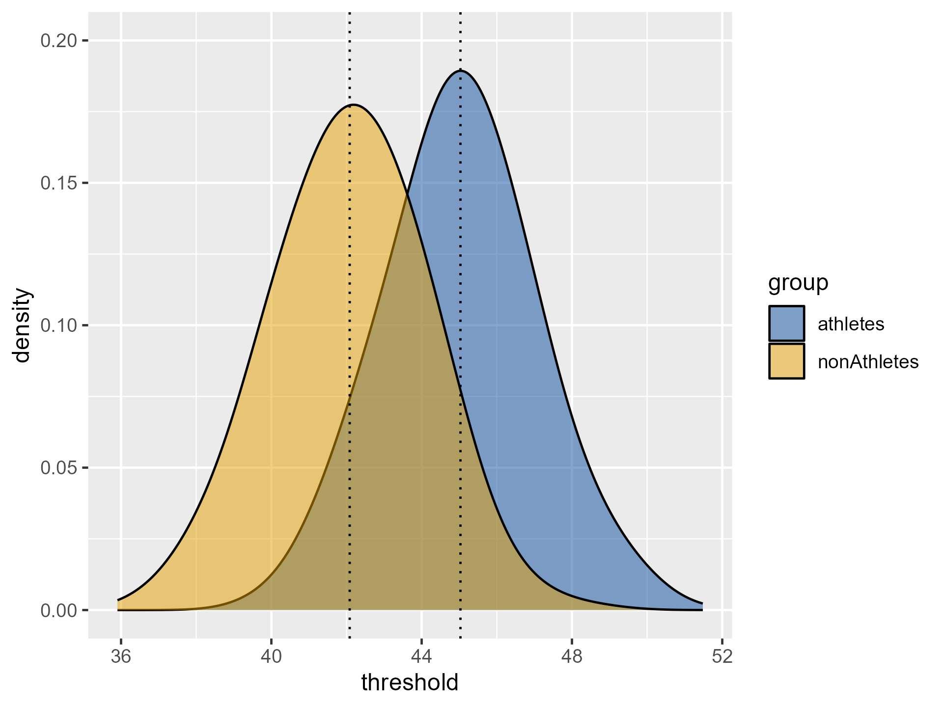
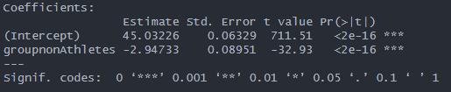
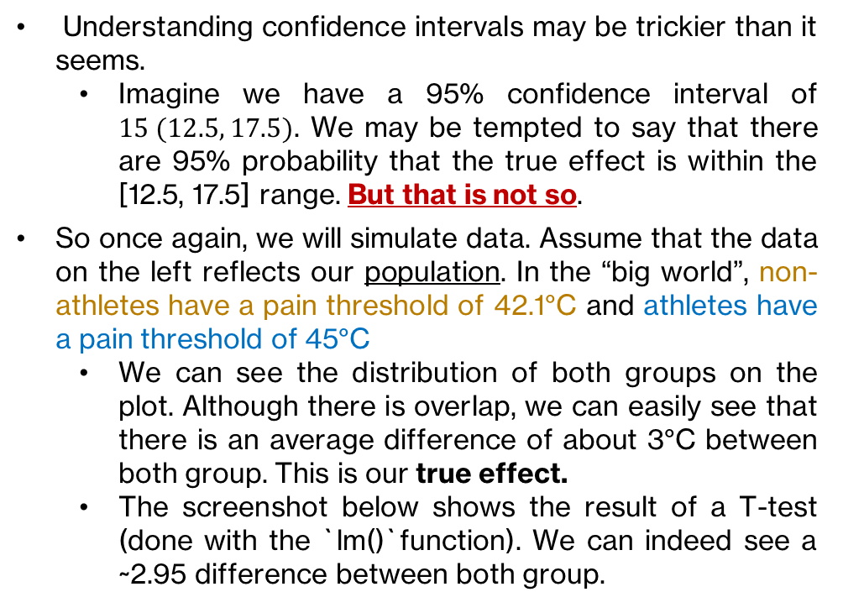
… as a frequentist
set.seed(123) # Always run before simulating data for reproducibility
# A tibble is a type of table used in R. They are similar to data frames.
population.data <- tibble(
group = rep(c(‘athletes’, ‘nonAthletes’), each = 1000),
threshold = c(rnorm(1000, mean = 45, sd = 2),
rnorm(1000, mean = 42, sd = 2) )
Understanding confidence intervals may be trickier than it seems.
Imagine we have a 95% confidence interval of $15 (12.5, 17.5)$. We may be tempted to say that there are 95% probability that the true effect is within the [12.5, 17.5] range. But that is not so.
So once again, we will simulate data. Assume that the data on the left reflects our population. In the “big world”, non-athletes have a pain threshold of 42.1°C and athletes have a pain threshold of 45°C
We can see the distribution of both groups on the plot. Although there is overlap, we can easily see that there is an average difference of about 3°C between both group. This is our true effect.
The screenshot below shows the result of a T-test (done with the `lm()`function). We can indeed see a ~2.95 difference between both group.
42.1°C
45°C
See Amanda et al., Sports Med, 2022 for more info on pain perceptions in athletes.

Slide 26
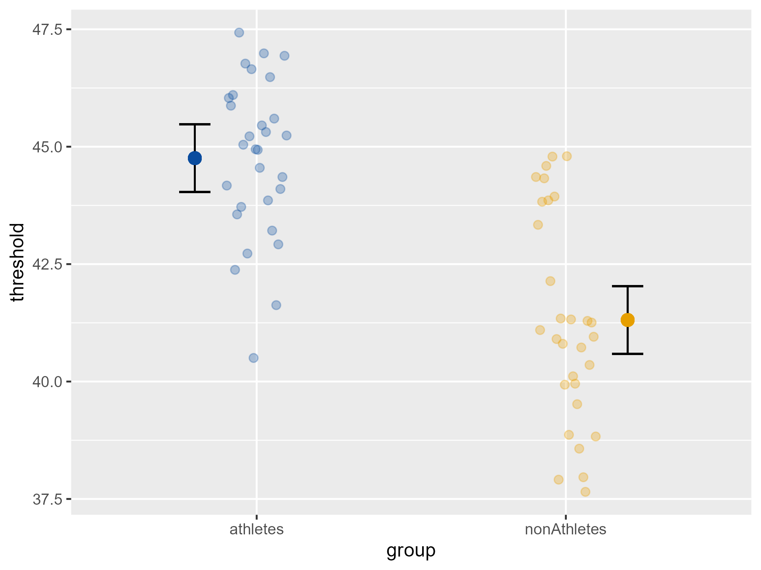
… as a frequentist
In experimental science, we seldom have access to an entire population. Instead, we have to sample from it by recruiting participants.
This recruitment process is similar to the `sample()` method in R.
Here is a breakdown of the code on the left.
sample.data is a tibble containing 30 random subjects from the population for both groups.
sample.lm contains the t-test results
Wrapping `summary()`around sample.lm allows to print the result of the t-test
Wrapping `confint()` around sample.lm allows to print the confidence interval around the point estimate.
The `emmeans()` function allows to easily pull the estimated marginal mean of each groups, along with their standard error and confidence interval.
The t-test reveals a difference of 3.45 °C (2.43, 4.47).
The figures in parentheses are the 95% confidence interval. Again, it is tempting to say that there is 95% probability that the true value is within this range. In this case, it is the case. But we shouldn’t interpret the confidence interval this way…
set.seed(123)
# Let's recruit some participants
sample.data <- population.data %>%
group_by(group) %>%
sample_n(size = 30)
sample.lm <- lm(data = sample.data, threshold ~ group)
summary(sample.lm)
confint(sample.lm)
emmeans::emmeans(sample.lm, ~ group)

Slide 27
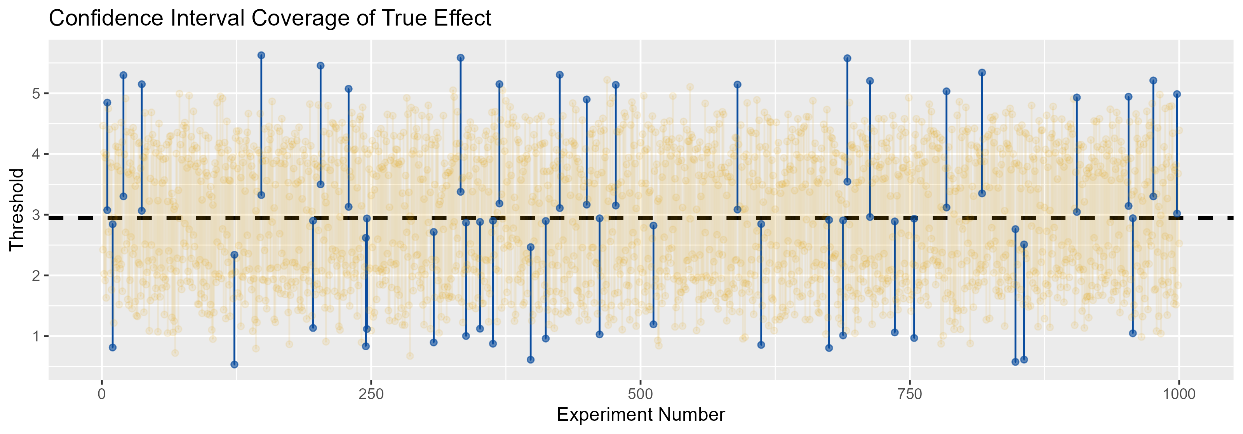
… as a frequentist
The graph below shows the coverage of confidence intervals of 1000 individual experiments.
Each experiment consist of a sample size of ~30 (common in experimental biomedical fields). In other words, 30 subjects were chosen at random in the entire population we have simulated previously.
On the graph:
The dashed line represents the true effect (i.e., the true average differences between athletes and non-athletes).
Yellow indicates the experiments that covered the true value within their 95% confidence interval.
Blue indicates the experiments that did not cover the true value within their 95% confidence intervals.
We can count 41 experiments that failed to cover the true effect. In this case, ~96% of the experiment were able to include the true effect in their respective interval.
See Amanda et al., Sports Med, 2022 for more info on pain perceptions in athletes.

Slide 28
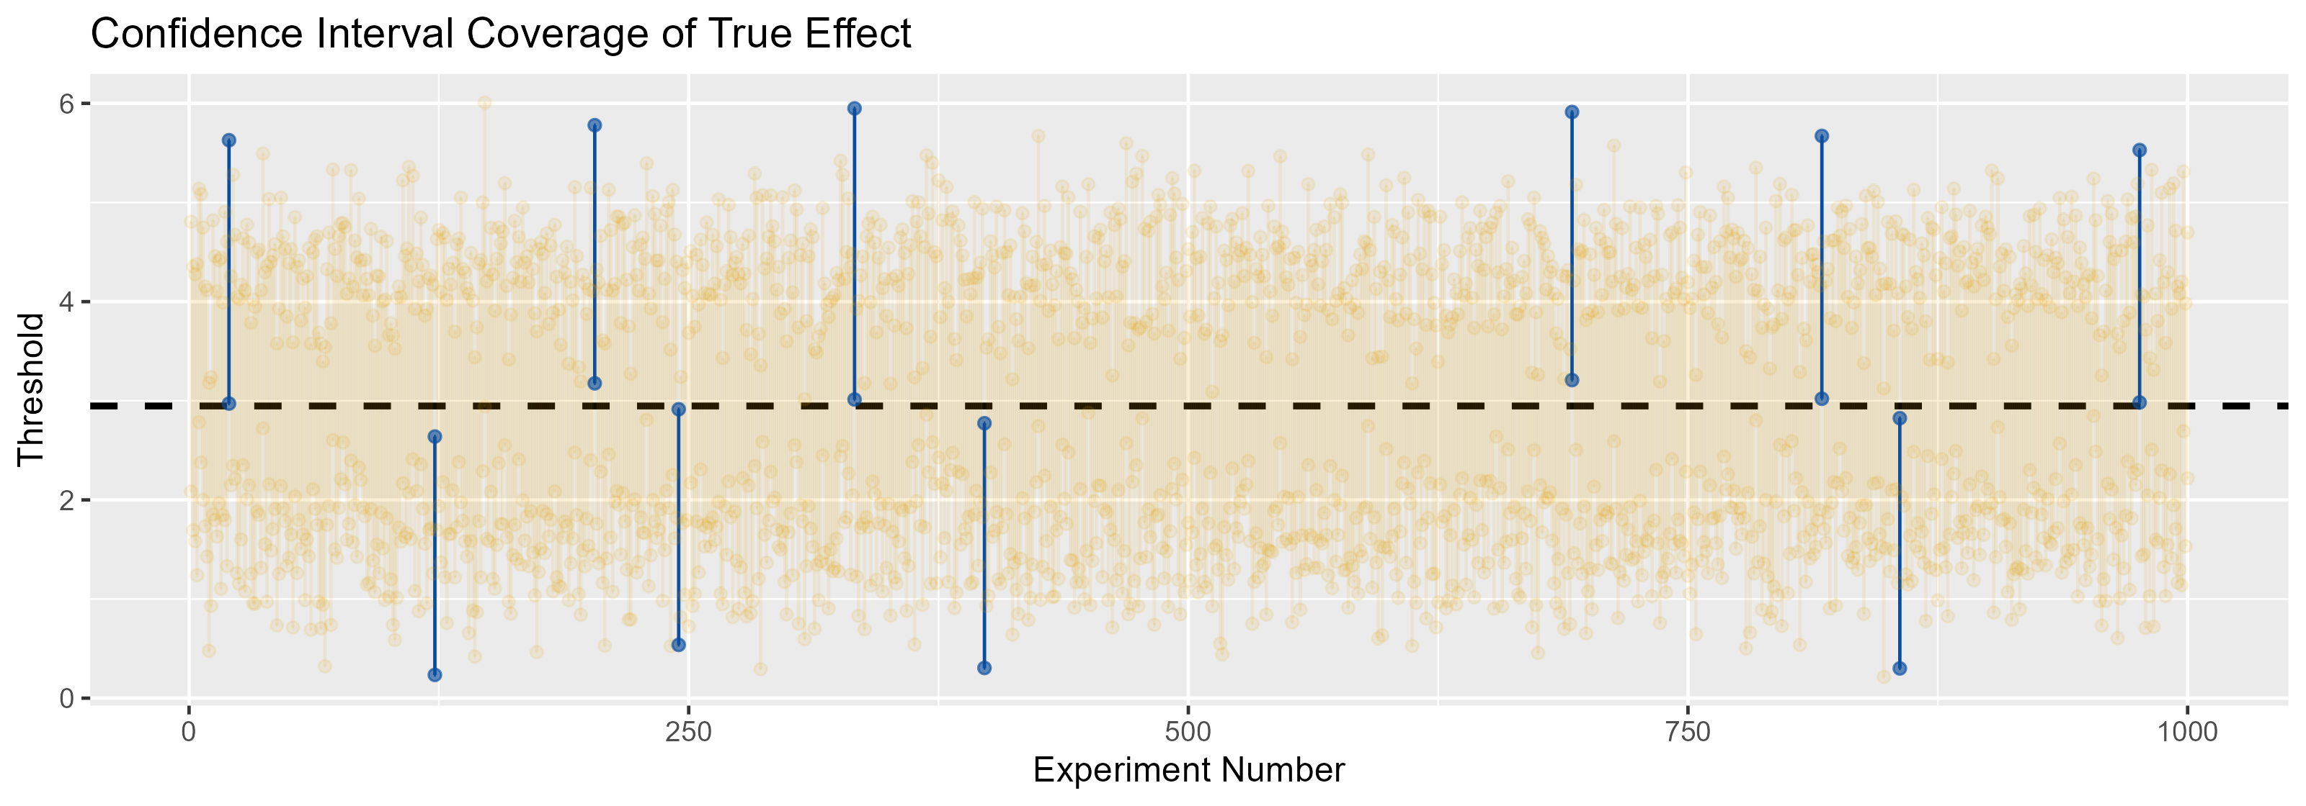
… as a frequentist
The graph below shows the coverage of confidence intervals of 1000 individual experiments.
Instead of the traditional 95%, we used 99% confidence interval here. We now see there are fewer experiments that do not cover the true value. However, the confidence intervals are also wider, so this comes at a loss of precision.
💡
The takeaway here is that the frequentist approach is based on the long run. While we cannot say that there are 95% probability that the true effect lies within our current confidence interval, we can say that, assuming our chosen model, we are 95% confident that the true effect lies within the confidence interval. This is true, because the actual true effect be captured 95% of the time if we were to repeat the experiment a large number of time.
See Amanda et al., Sports Med, 2022 for more info on pain perceptions in athletes.

